Slide 1

The Importance of Changing Passwords & Using MFA

Slide 2
Agenda
Duration: 15 – 30 minutes
Audience: General Staff
Goal: Help users understand why regular password changes and MFA matter for both personal and organizational security.

Slide 3
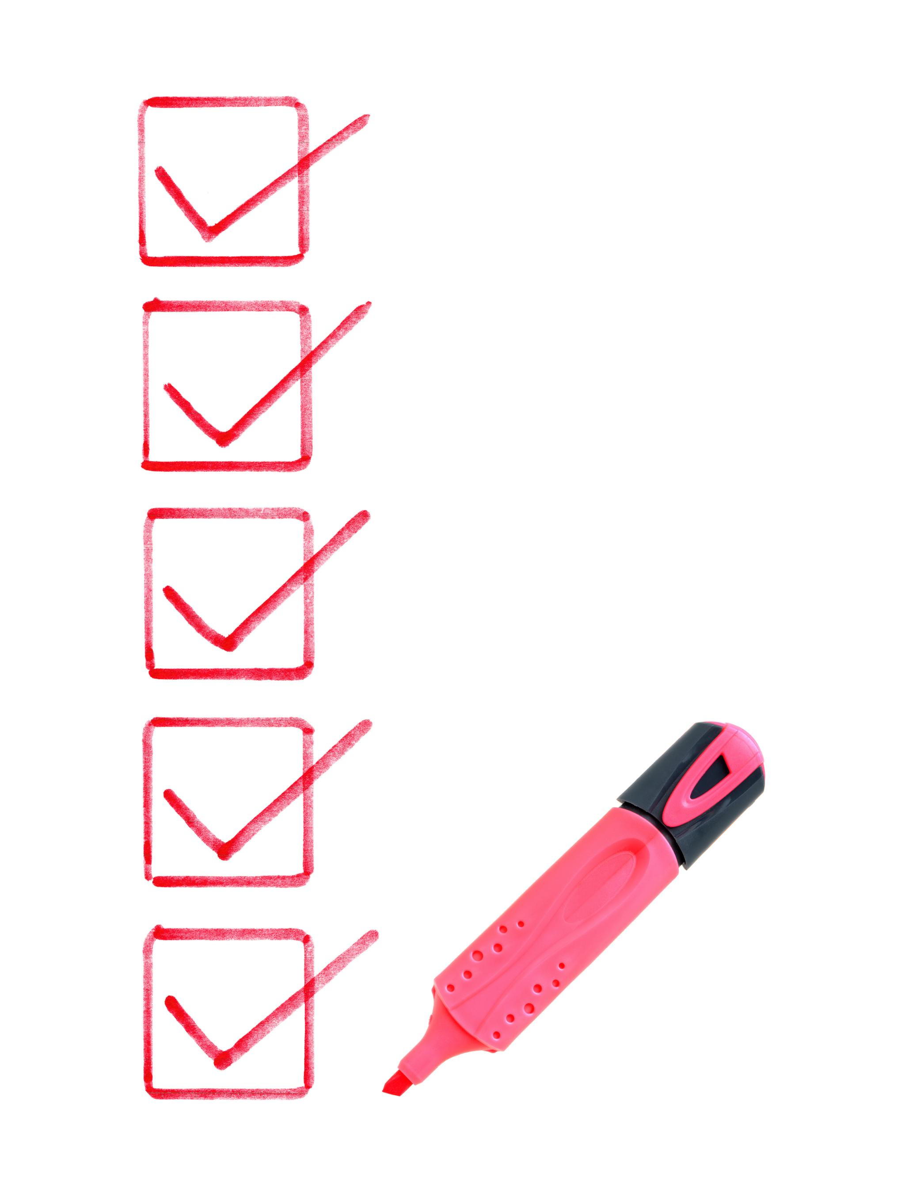
Main Agenda
Understanding Phishing Attacks and Their Risks
Best Practices for Password Management
The Role of Multi-Factor Authentication
Enhancing Overall Security Measures
Final Thoughts and Recommendations

Slide 4
Why Changing Passwords Matters?
What’s the Risk?
Passwords can be leaked in data breaches.
Many people reuse passwords across work and personal accounts.
Cybercriminals use tools to crack weak or old passwords.
Best Practices
Change passwords every 90 – 180 days (or sooner if a breach is suspected).
Don’t use names, birthdays, or common words.
Use long passphrases (e.g., “Sunsets&Coffee4Ever!”).

Slide 5
What is MFA?
Stands for Multi-Factor Authentication.
A security method that requires two or more of the following:
Something you know (your password).
Something you have (a code from an app or text)
Something you are (fingerprint or face scan).
Why It Works?
Even if a hacker steals your password, they still can’t log I without the second factor.
A company avoided a ransomware attack because an attacker had an employee’s password – but couldn’t bypass the MFA prompt on their phone.

Slide 6
Quick Activity
Example Questions:
What is one reason you should change your password regularly?
True or False: MFA makes it harder for hackers to access your account.
Which is the following is the strongest password?
Password123
CoffeeMug!2023
!Gx79&@3p$2rM
Bonus question: When was the last time you changed your work password?
Bonus question: Who’s already using MFA on their personal accounts or applications?

